Slide 1


Course: Data Structure​
(Course Code: ETCCDS202 )​
​
UNIT-1: Foundations of Data Structures​
Dr. Shahjad, Mr. Deepak, Neetu Ma’am​
School of Engineering & Technology
K.R. Mangalam University
Notes:
New Courses replaced with New Programmes

Slide 2

SESSION 7:
Greedy Algorithms & Dynamic Programming
Notes:
New Courses replaced with New Programmes

Slide 3
Recap: Divide & Conquer Paradigm
Divide & Conquer solves large problems by breaking them into smaller ones.
Core idea: Break → Solve → Combine
Three Steps
Divide – Split the problem
Conquer – Solve subproblems (recursively)
Combine – Merge results
Real-Life Example
Dictionary search → Open in the middle, keep dividing until the word is found.
Notes:
New Courses replaced with New Programmes

Slide 4
Recap: Divide & Conquer Paradigm
Key Algorithm Examples
Binary Search – Divide search space
Merge Sort – Divide array, merge sorted parts
Quick Sort – Divide using pivot
⏱ Why It Is Efficient
Problem size reduces at each step
Fewer comparisons
Faster than linear methods
Notes:
New Courses replaced with New Programmes

Slide 5
Recap: Divide & Conquer Paradigm
Example:
Linear Search → O(n)
Binary Search → O(log n)
Important Notes
Not random splitting
Not suitable for all problems
Works best with independent subproblems
One-Line Takeaway
Divide & Conquer improves efficiency by solving smaller parts of a problem and combining their solutions.
Notes:
New Courses replaced with New Programmes

Slide 6
Learning Objectives
After this lecture, students will be able to:
Explain Greedy and Dynamic Programming approaches
Identify problems suitable for each approach
Compare Greedy vs DP
Apply them to real-world problems
Understand why DP guarantees optimal solutions
Notes:
New Courses replaced with New Programmes

Slide 7
What is a Greedy Algorithm?
A Greedy algorithm:
Makes the best local choice
Hopes this leads to the global solution
Never reconsiders decisions
Key idea: “Pick the best option now”
One-line intuition: “At every step, choose what looks best right now.”
Notes:
New Courses replaced with New Programmes

Slide 8
What is a Greedy Algorithm?
Formal Definition (Exam-Oriented)
A greedy algorithm is an
optimization technique that constructs a solution
step by step
by choosing the locally optimal option
at each stage,
without reconsidering previous decisions.
Notes:
New Courses replaced with New Programmes

Slide 9
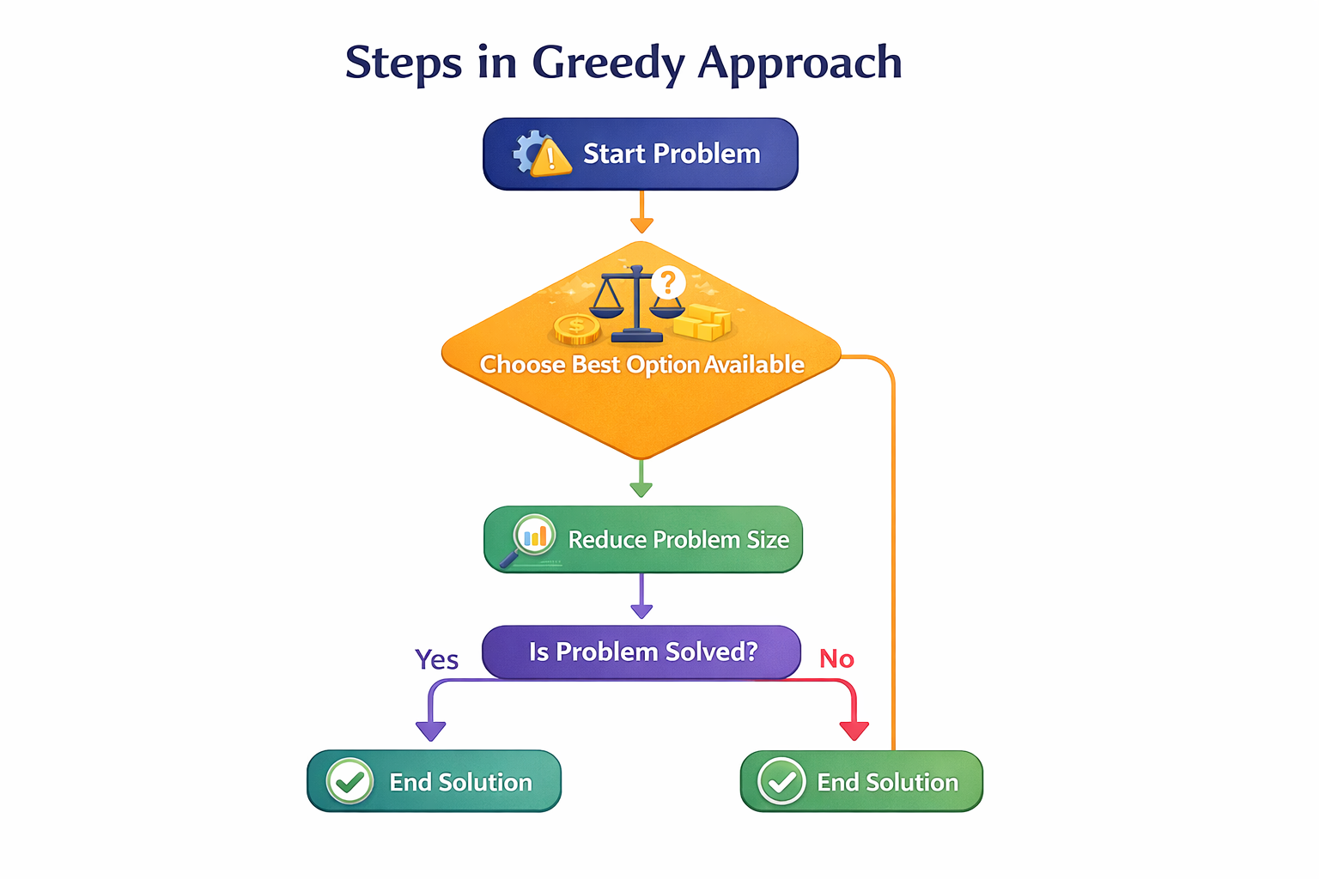
Greedy Strategy
Flowchart of Greedy Strategy
Notes:
New Courses replaced with New Programmes

Slide 10
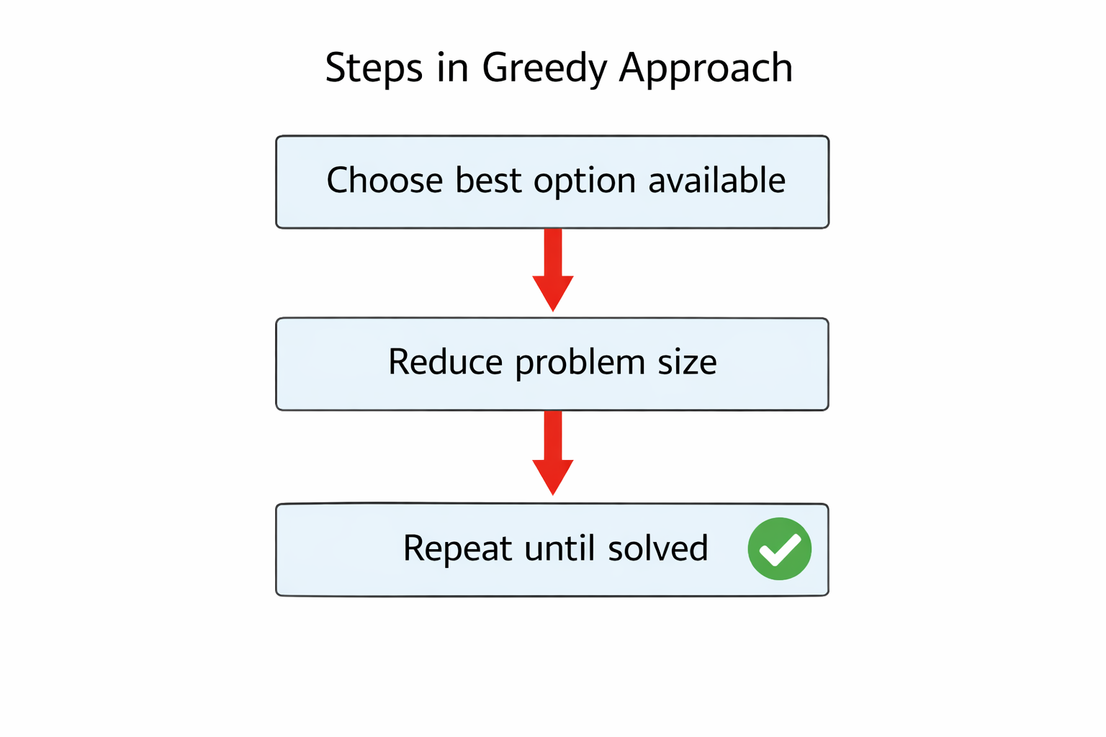
Greedy Strategy..
Steps in Greedy Approach
Choose best option available
Reduce problem size
Repeat until solved
Notes:
New Courses replaced with New Programmes

Slide 11
How does a greedy algorithm work
To understand how a greedy algorithm works, let’s break it down into simple steps:
Make a choice – At each step, pick the best available option based on a specific criterion.
Proceed to the next step – Move forward and repeat the process until the problem is solved.
Check the final outcome – The algorithm arrives at a solution that is either optimal or close to optimal.
Notes:
New Courses replaced with New Programmes

Slide 12
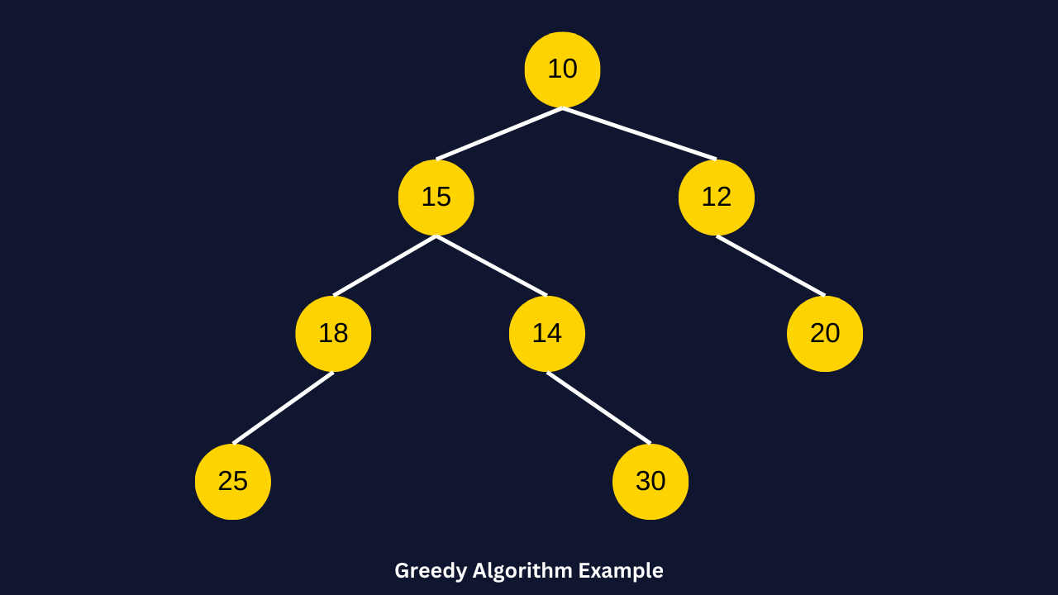
EXAMPLE 1
For example, consider the following tree structure, where each node represents a weight, and our goal is to find the longest path (maximum sum) from root to leaf.
So, the criterion in this example is selecting the largest weight at each step.
Notes:
New Courses replaced with New Programmes

Slide 13
Solution
In this tree, each number represents a weight, and we need to find the path from the root (10) to a leaf node that yields the highest sum.
Applying the greedy algorithm
Start at the root (10).
Left child: 15
Right child: 12
Greedy choice: Pick 15 (since it’s the largest).
Move to node (15).
Left child: 18
Right child: 14
Greedy choice: Pick 18 (since it’s the largest).
Move to node (18).
Left child: 25
No right child.
Greedy choice: Pick 25 (since it’s the only option).
Final Path Chosen by Greedy Algorithm:
10 → 15 → 18 → 25
Total sum: 10 + 15 + 18 + 25 = 68
Notes:
New Courses replaced with New Programmes

Slide 14
Solution..
Checking the optimal path
Now, let’s explore all possible paths:
Greedy path:
10 → 15 → 18 → 25
Sum = 68
Alternative path:
10 → 15 → 14 → 30
Sum = 10 + 15 + 14 + 30 = 69 Higher than greedy choice!
Other path:
10 → 12 → 20
Sum = 42 (Lower)
Notes:
New Courses replaced with New Programmes

Slide 15
Why did the greedy approach fail?
Chose 15 over 12 (Correct choice here)
Chose 18 over 14 (Mistake! Because 14 leads to 30, which gives a better sum!)
The best global solution was 10 → 15 → 14 → 30, with a sum of 69, but the greedy algorithm missed it because it made decisions greedily at each step instead of considering the full path.
Now, let’s discuss these characteristics of the greedy algorithm in the next section.
Notes:
New Courses replaced with New Programmes

Slide 16
Example 2: Coin change problem
The Coin Change problem is a classic example of a greedy algorithm in action.
The task is:
given a set of coin denominations,
determine the minimum number of coins required to make a specific amount.
Notes:
New Courses replaced with New Programmes

Slide 17
Real-Life Greedy Example
Example: Selecting Coins for Change
Always pick the largest coin
Continue until amount is zero
Fast and simple, but not always optimal
Concrete example = better retention
Notes:
New Courses replaced with New Programmes

Slide 18
Classical Greedy Problems
Common Greedy Algorithms:
Activity Selection
Fractional Knapsack
Huffman Coding
Dijkstra’s Algorithm
✔ One algorithm = one concept

Slide 19
Limitation of Greedy Approach
Key Limitation
Greedy does not guarantee optimal solution
Wrong local choice → wrong final answer
Example: Coin change with non-standard coins
Misconception correction (important slide)

Slide 20
What is Dynamic Programming (DP)?
Definition Dynamic Programming:
Breaks problem into subproblems
Stores results of solved subproblems
Reuses them to build optimal solution
Key idea: “Solve once, remember forever”

Slide 21
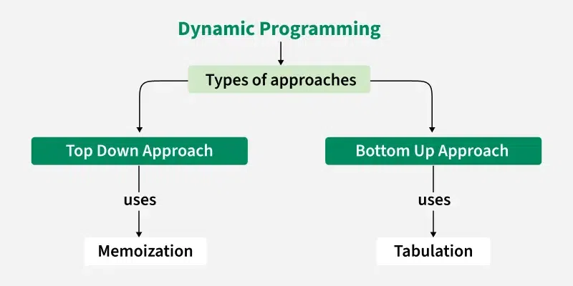
Types of Approaches

Slide 22
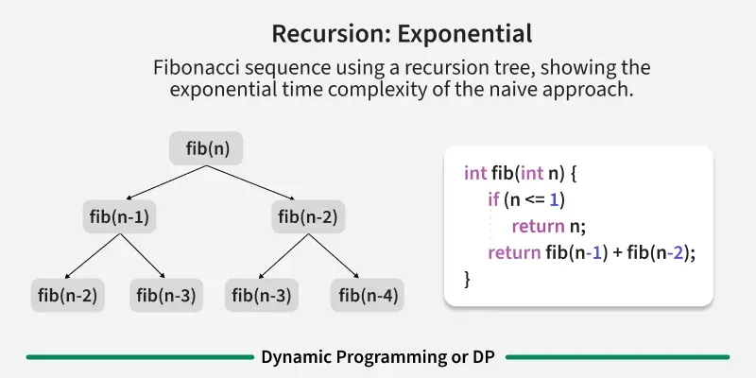
Example 1

Slide 23
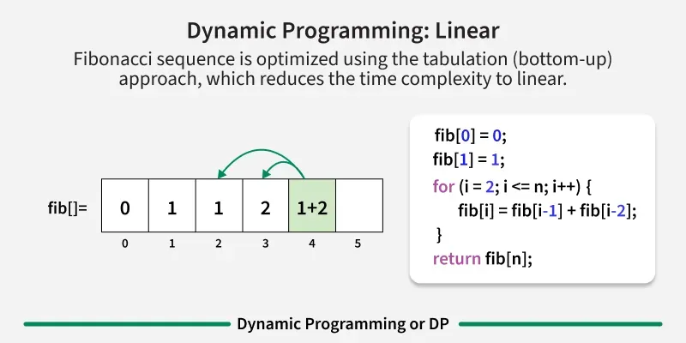
Example 2

Slide 24
DP Strategy (Two Properties)
Dynamic Programming works when:
Overlapping subproblems
Optimal substructure
Highlight keywords
Avoid formulas here

Slide 25
CONT..
So we can conclude that −
The problem should be able to be divided into smaller overlapping sub-problem.
Final optimum solution can be achieved by using an optimum solution of smaller sub-problems.
Dynamic algorithms use memorization.

Slide 26
Real-Life DP Example
Example: Saving Exam Results
Instead of recalculating marks again and again
Store previous results and reuse
Saves time and effort

Slide 27
Classical Dynamic Programming Problems
Popular DP Problems:
Fibonacci Series
0/1 Knapsack
Longest Common Subsequence
Matrix Chain Multiplication
📌 Show how DP improves efficiency

Slide 28
Greedy vs Dynamic Programming (Comparison)
Aspect | Greedy | Dynamic Programming
Decision | Local | Global
Optimal Solution | Not guaranteed | Guaranteed
Speed | Faster | Slower
Memory | Low | High

Slide 29
Greedy Algorithm Questions
Define a Greedy Algorithm and explain its main idea.
List the key properties a problem must have to be solved using a greedy approach.
Explain the difference between Greedy Algorithm and Dynamic Programming.
Application & Problem-Solving
Explain the coin change problem using a greedy approach. Is greedy always optimal for all coin systems? Explain.
Define Dynamic Programming (DP). How does it differ from recursion?
Explain overlapping subproblems and optimal substructure with examples.
What is the difference between Top-Down (Memoization) and Bottom-Up (Tabulation) DP approaches?
Application & Problem-Solving

Slide 30
Reflection, Practice & Homework
Reflection
When should we use Greedy?
Why is DP more reliable?
Homework
Identify Greedy or DP for given problems
Compare Greedy vs DP for Knapsack

Slide 31
THANK YOU

